Slide 1


Workshop: Response Bias in Self-Report Measurements Acquiescence
Dr. Ricardo Primi
Universidade São Francisco (USF) and Ayrton Senna Institute Edulab21 (IAS)
Dr. Felipe Valentini
Universidade São Francisco (USF)
ITC Granada, Sapain, July, 2024
Notes:
I would like to thank you for your attention, the search committee, and GSE for the opportunity to discuss my work
I am really honored to be here

Slide 2
What is acquiescence ? What is it role on the validity of the assessments? Whay e do need positive vs negative item poles

Slide 3
Cognitive response process

Slide 4
Cognição : understanding, experience, self-reflection
Response styles (ACQ, DSACQ, ERS, MRS)
Group Reference Bias
Duckworth AL, Yeager DS. Measurement Matters: Assessing Personal Qualities Other Than Cognitive Ability for Educational Purposes. Educ Res. 2015 May;44(4):237-251. doi: 10.3102/0013189X15584327. PMID: 27134288; PMCID: PMC4849415.
Social desirability: self deception and voluntary IM

Slide 5
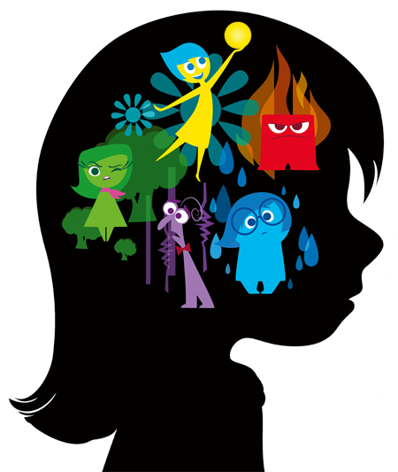
Self-report is a rater mediated assessment
Language
Gc/Grw
LT Memories
Persistence
I give up easily ?
Response styles
I do more ?
I remain interested?
Motivation
Past self
Self reporting
Notes:
Dos varios problemas .. Vou tartar de um estilos especifico .. Aquiescence
Riley

Slide 6
What is acquiescence?

Slide 7

What is acquiescence?
Messick (1966) proposes at least two aspects of acquiescence:
Interpretive acquiescence: difficulty interpreting statements unambiguously, inability to differentiate or particularize, negatively associated with verbal comprehension skills,
Impulsive acceptance: tendency to react quickly and impulsively with little reflection and probably little monitoring of performance (unreflective impulsiveness)
Low Gc/Grw/Gkn
I am often talkative
Personality trait
ACQ index
+
IEF Insufficient Effort or Careless Responding
Positive pole items
+
Confirmation bias
+
True target Trait
Trait score
-
Negative pole items
I am often quiet
Notes:
We know what we measure but we don’t know exactly what it is
The two aspects are important because they are systematic errors that we want to get rid of in order to have a better measure of the trait !!

Slide 8
How to measure acquiescence?
Acquiescence Index (acq_index)

Slide 9


Inconsistent agreement responses
index from positive pole vs negative pole items
Consistent responses
When confronted with a problem I do more than it is expected of me
5
4
3
2
1
1
2
3
4
5
When confronted with a problem I give up easily
High persistence
Low persistence

Slide 10
Inconsistent agreement responses
index from positive pole vs negative pole items
Consistent responses
5
4
3
2
1
1
2
3
4
5
M = 3
M = 3
M = 3
M = 3
M = 3

Slide 11
Inconsistent agreement responses
index from positive pole vs negative pole items
Inconsistent responses
When confronted with a problem I do more than it is expected of me
5
5
5
5
2
3
4
5
M = 4,5
M = 5
M = 3,5
M = 4
When confronted with a problem I give up easily
High inconsistent
agreement
Consistent
Notes:
Acquiescence (agreement regardless of content)
The reverse is also true (as in inconsistent disagreement)
We can create an index: consistent responses are equal to 3 (2,5) and inconsistent responses are those that deviate from 3 (above or below)
We identified 18 pairs on PISA database and calculated this index.
This score can be associated with several possibilities. One is low motivation/low effort in reading questions
If so it will be related to low achievement

Slide 12
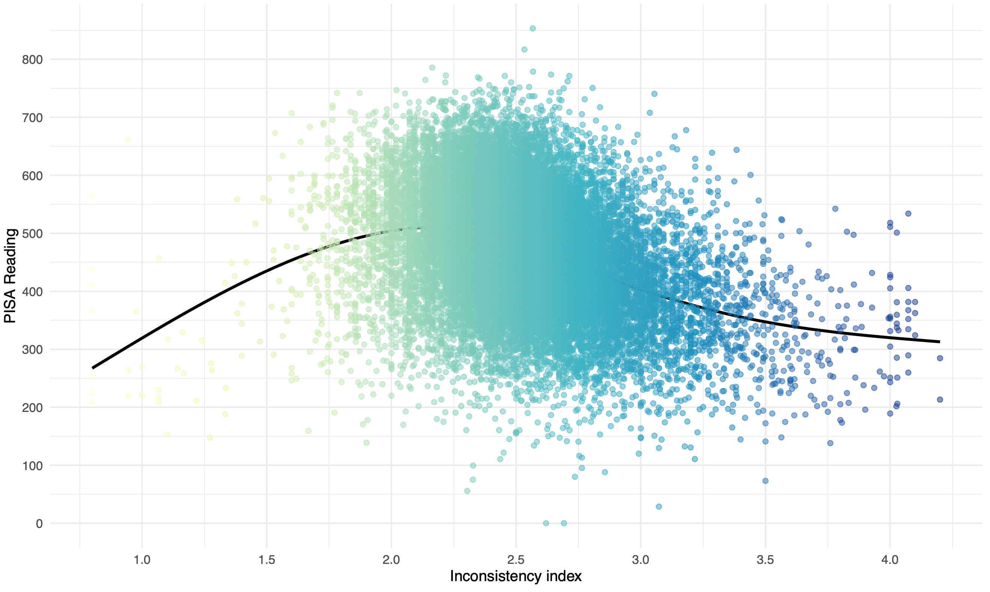
Inconsistency vs achievement
Inconsistency -> low achievement
r = -.32
Notes:
Sure enough

Slide 13
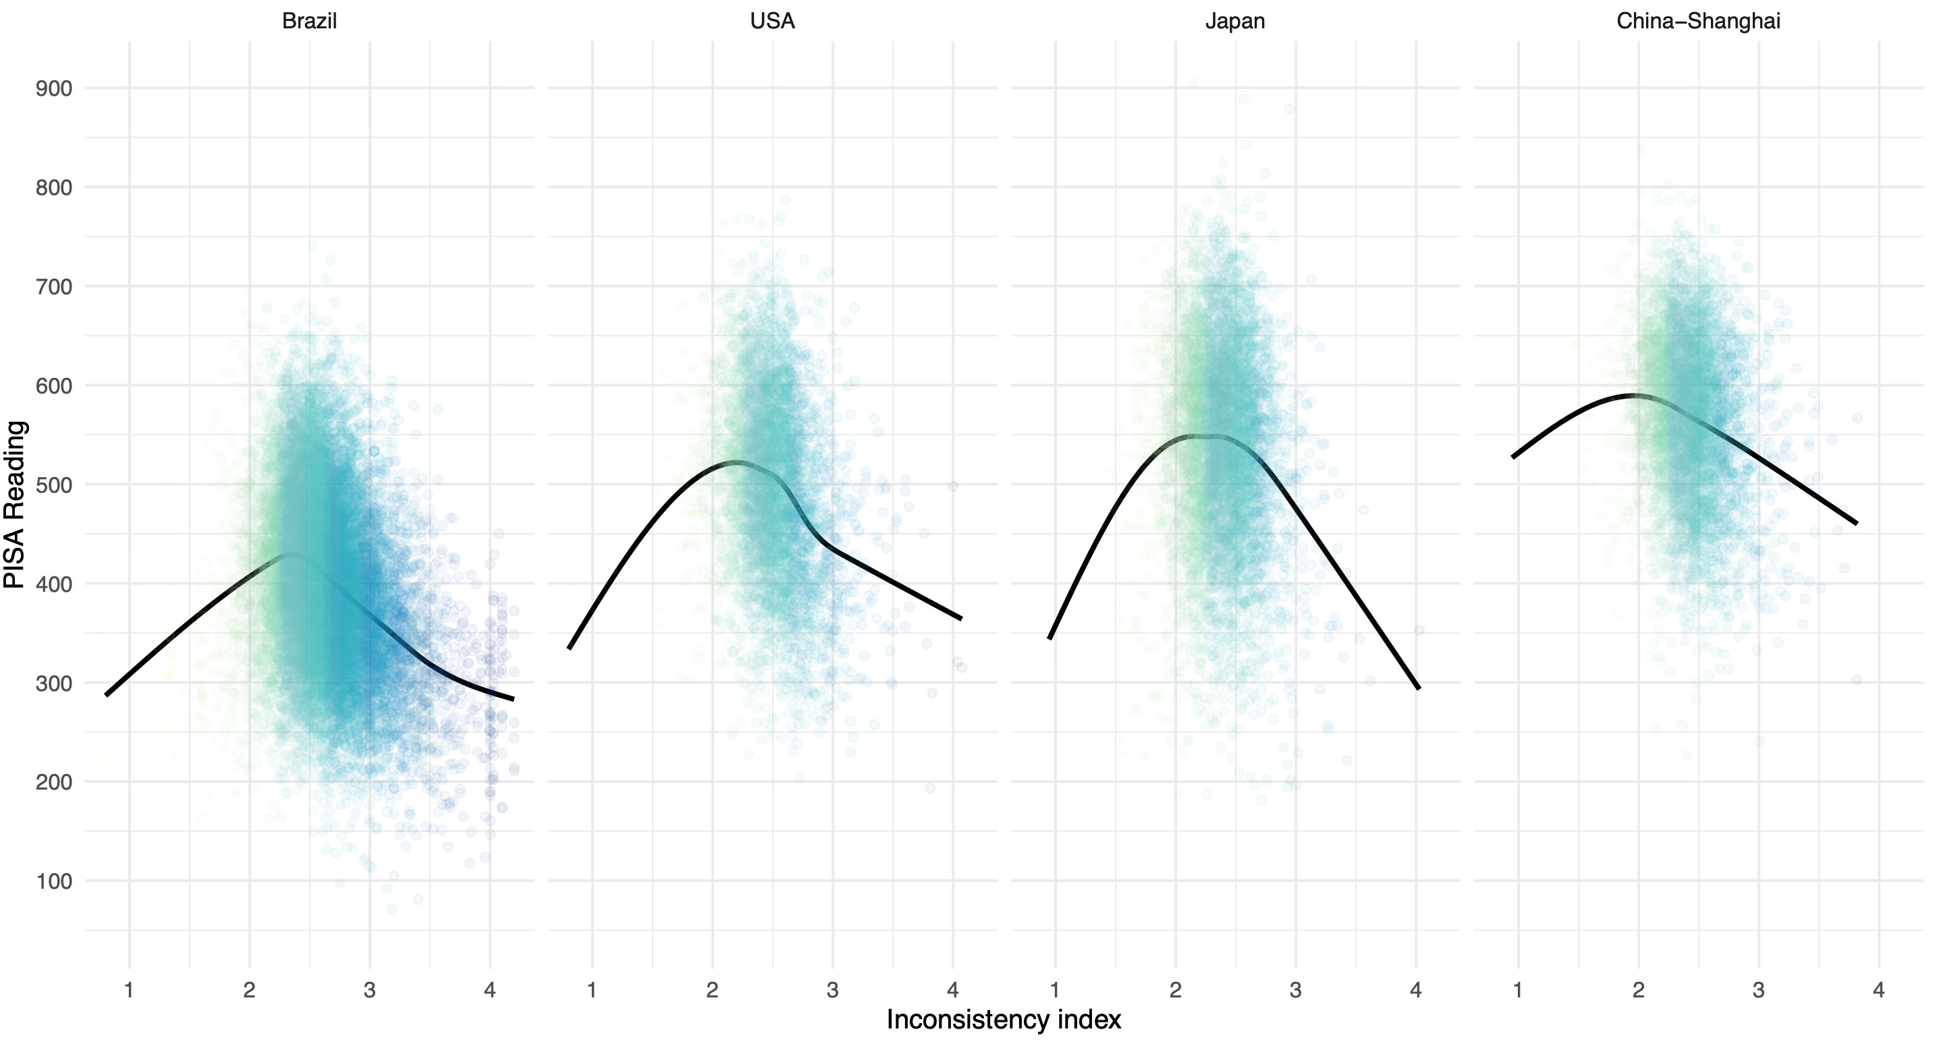
Inconsistency vs achievement
inconsistency vary by country

Slide 17
Note …
In order to measure acquiescence we need negatively phrased items (antonyms)
If you search in the literature if it is worth using negatively phrased items:
NO
Use of negatively phrased items are difficult to read
They can “cause” problems in internal structure (positive vs negative factors, so that you cannot sum into a singe dimension )
Use of negatively phrased items degrade reliability
YES
You can calculate acquiescence bias and correct scores and ending up having more valid measures
Yes because you measure the low end of a construct

Slide 19
Spoiler alert .. The truth is ..
Language issue
Negative pole items via negations “I fulfill tasks I commit to” vs “I do not fulfill tasks I commit to”
Via antonyms/asserting opposites, “I have difficulties in fulfilling what I promised”
Internal structure validity
Internal structure is affected suppression effect of acquiescence.
Unbalanced scales (only positive pole items) are also affected but in a different way with misleading high reliability because of acquiescence inflation effects.
High reliability may be in part due systematic error variance (construct irrelevant variance)
Pure measure ?
Acquiescence correction is a “partialing out” mechanism
At group level (variance). Not at individual level. It mute individual cases with inconsistent responding
Total scores Balanced scales has acquiescence removed while we sum scores so what we see in item factor analysis is not what you get when you go to total scores.

Slide 20
Correcting for acquiescence?

Slide 21
Correcting for acquiescence (removing acquiescence variance from item and scale scores).
In general terms acquiescence may be defined as the discrepancy between the average over opposites and the scale midpoint (Hofstee, Berge, & Hendriks,1998)
5
I am often talkative
5 + 1 = 6/2 = 3
1
3 – 3 = 0
I am often quiet
3.5
5
5 + (-0.5) = 4.5
3.0
I am often talkative
2
5 + 2 = 7/2 = 3.5
I am often talkative
2 + (-0.5) = 1.5
I am often quiet
3 – 3.5 = -0.5
I am often quiet
Notes:
We know what we measure but we don’t know exactly what it is

Slide 22
Three methods for correcting for acquiescence?
Classic partialing out the mean
Person Differential Function
Multidimensional Item Response Theory (Random Intercept)

Slide 23
Is Aquiescence DPF? We compared 3 methods
Classical method partialling out the mean;
Rasch approach to measure Diferential Person Functioning (DPF)
Multidimensional Item Response Theory (MIRT) with random intercept

Slide 24
https://github.com/rprimi/acqu_mirt

Slide 25
Psychometrics of the classical method

Slide 26
Classical method partialling out the mean

Slide 27
Correcting for acquiescence (removing acquiescence variance from item and scale scores).
In general terms acquiescence may be defined as the discrepancy between the average over opposites and the scale midpoint (Hofstee, Berge, & Hendriks,1998)
5
I am often talkative
5 + 1 = 6/2 = 3
1
3 – 3 = 0
I am often quiet
3.5
5
5 + (-0.5) = 4.5
3.0
I am often talkative
2
5 + 2 = 7/2 = 3.5
I am often talkative
2 + (-0.5) = 1.5
I am often quiet
3 – 3.5 = -0.5
I am often quiet
Notes:
We know what we measure but we don’t know exactly what it is

Slide 29
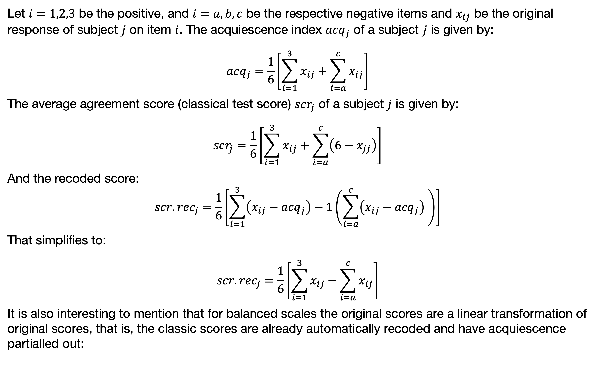
Summary of the classical perspective
Let $i=1,2,3$ be the positive, and $i=a,b,c$ be the respective negative items and $x_{ij}$ be the original response of subject $j$ on item $i$. The acquiescence index $acq_{j}$ of a subject $j$ is given by:
$$acq_{j}=\frac{1}{6}\left[\sum_{i=1}^{3}{x_{ij}}+\sum_{i=a}^{c}{x_{ij}}\right]$$
The average agreement score (classical test score) $scr_{j}$ of a subject $j$ is given by:
$$scr_{j}=\frac{1}{6}\left[\sum_{i=1}^{3}{x_{ij}}+\sum_{i=a}^{c}{\left(6−x_{jj}\right)}\right]$$
And the recoded score: $$scr.rec_{j}=\frac{1}{6}\left[\sum_{i=1}^{3}{\left(x_{ij}−{acq}_{j}\right)}−1\left(\sum_{i=a}^{c}{\left(x_{ij}−{acq}_{j}\right)} \right)\right]$$
That simplifies to:
$$scr.rec_{j}=\frac{1}{6}\left[\sum_{i=1}^{3}{x_{ij}}−\sum_{i=a}^{c}{x_{ij}}\right]$$
It is also interesting to mention that for balanced scales the original scores are a linear transformation of original scores, that is, the classic scores are already automatically recoded and have acquiescence partialled out:
https://osf.io/zsrwt

Slide 31
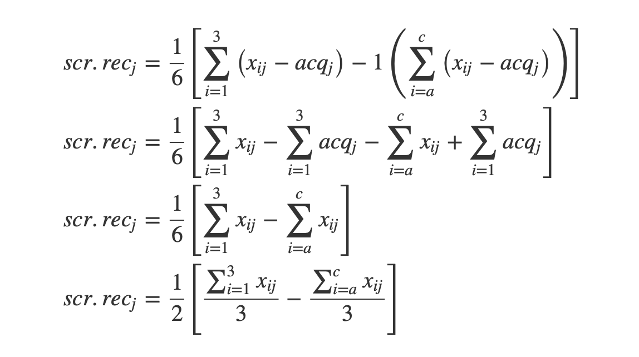
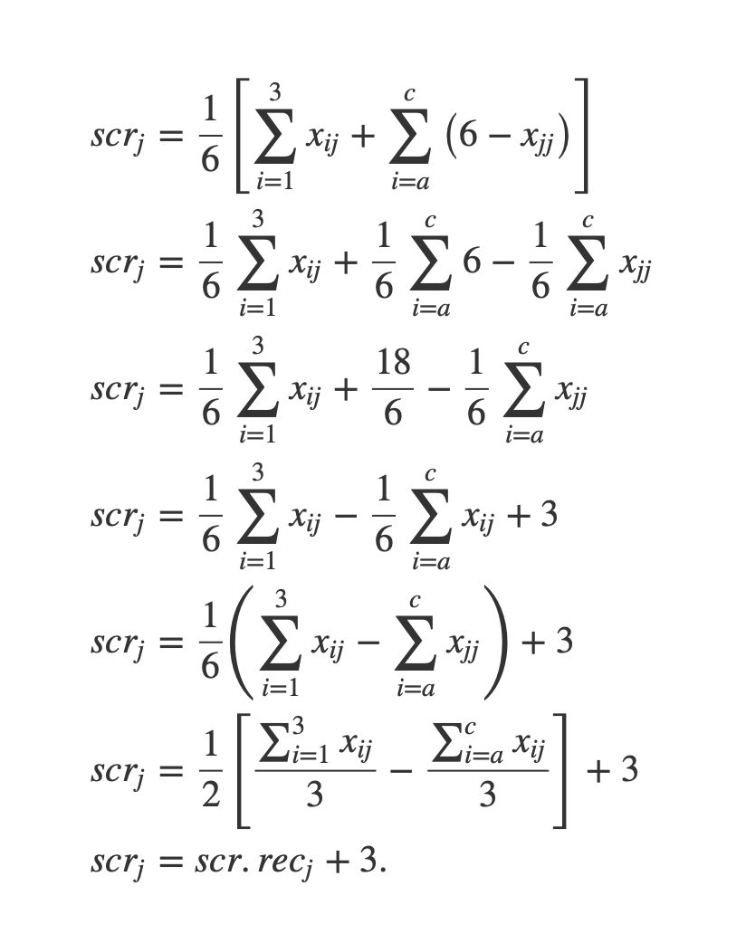
http://www.labape.com.br/acqu_mirt/methods_of_recoding.html

Slide 32
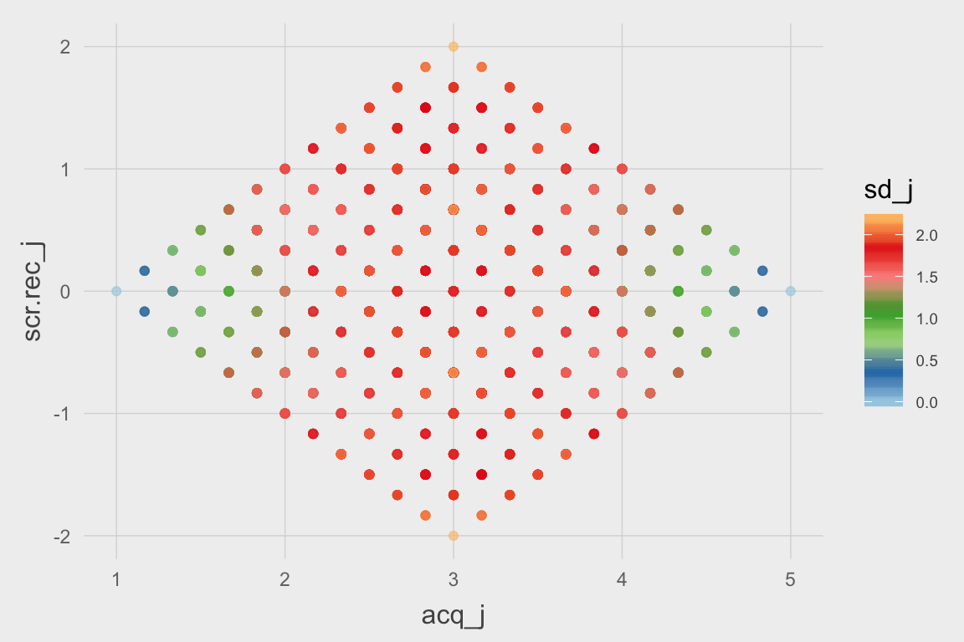

Slide 34
Acquiescence as a Person Differential Functioning DPF

Slide 35
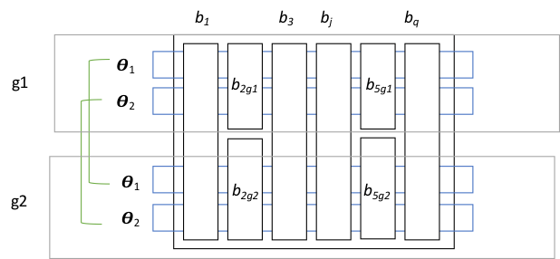
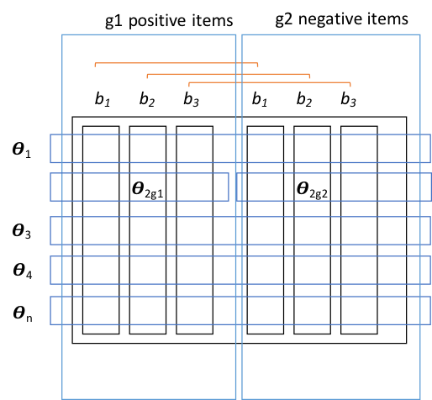
Acquiescece as a Diferential Person Functioning
Differential Item Functioning (DIF)
Differential Person Functioning (PDIF)

Slide 36
Rasch approach to measure Diferential Person Functioning (DPF)
Calibrate item difficulty
Estimates theta twice (+ and -) fixing item parameters at values found in step 1
Calculate the difference and se between two estimations = DPF
Doesn’t solve PDIF

Slide 37
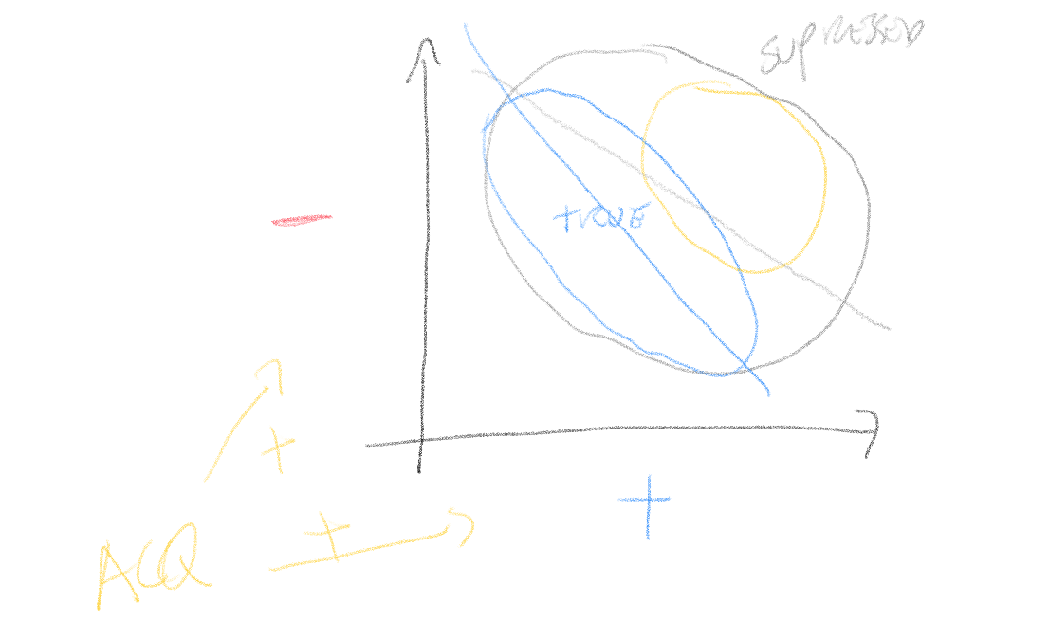
Note on Rasch classical way to testing unidimesnionality
Estimate measures with positive and negative items and check their correlation
Trevor Bond in Brazil USF in may 2017 !! ☺

Slide 38
Random Intercept MIRT

Slide 39
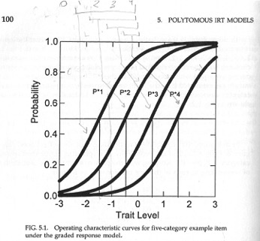
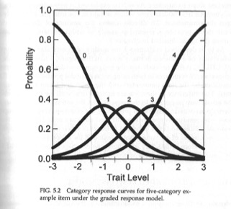
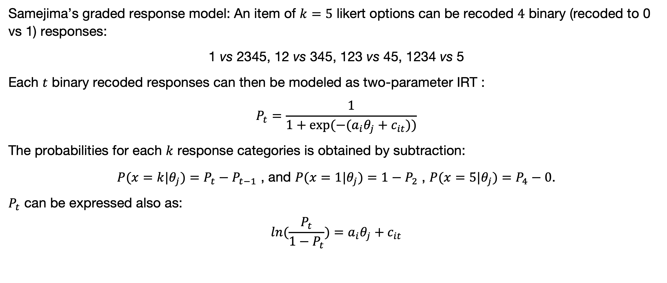
Multidimensional Item Response Theory (MIRT) with random intercept
Samejima’s graded response model: An item of $k=5$ likert options can be recoded $4$ binary (recoded to 0 vs 1) responses:
1 vs 2345, 12 vs 345, 123 vs 45, 1234 vs 5
Each $t$ binary recoded responses can then be modeled as two-parameter IRT :
$$P_{t}=\frac{1}{1+exp(−(a_{i}θ_{j}+c_{it}))}$$
The probabilities for each $k$ response categories is obtained by subtraction:
$P(x=k|θ_{j})=P_{t}−P_{t−1}$ , and $P(x=1|θ_{j})=1−P_{2}$ , $P(x=5|θ_{j})=P_{4}−0$.
$P_{t}$ can be expressed also as: $$ln(\frac{P_{t}}{1−P_{t}})=a_{i}θ_{j}+c_{it}$$

Slide 40
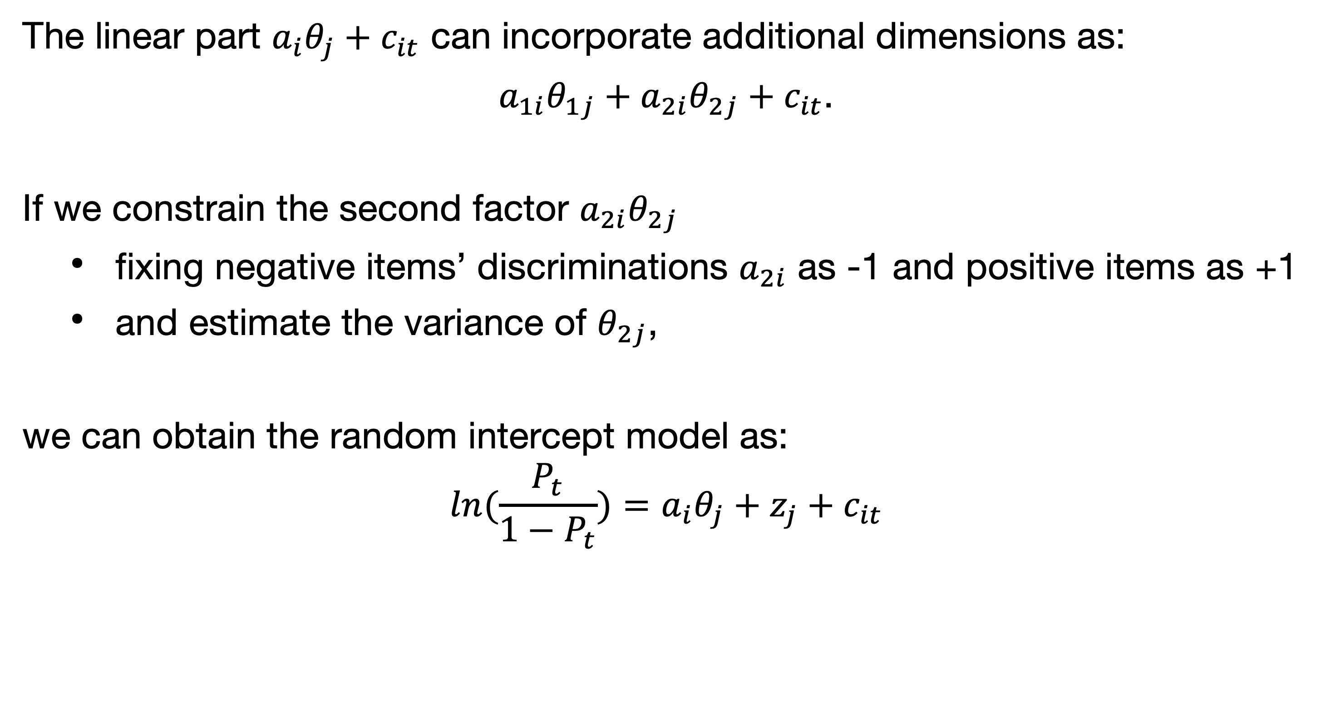
Adapted Samejima’s graded response to estimate random intercept model
The linear part $a_{i}θ_{j}+c_{it}$ can incorporate additional dimensions as:
$a_{1i}θ_{1j}+a_{2i}θ_{2j}+c_{it}$.
If we constrain the second factor $a_{2i}θ_{2j}$
fixing negative items’ discriminations $a_{2i}$ as -1 and positive items as +1
and estimate the variance of $θ_{2j}$,
we can obtain the random intercept model as:
$$ln(\frac{P_{t}}{1−P_{t}})=a_{i}θ_{j}+z_{j}+c_{it}$$

Slide 42
Goal and hypothesis
We wanted to prove that aquiescesse is DPF
Hypothesis
Index of acquiescence = DPF = Random Intercept
Total scores from balanced scales = DPF corrected scores = substantive factor in random intercept model

Slide 43
Method
Participants
40,649 students
55.1% females from 495 schools located in 232 cities in the State of São Paulo Brazil,
Ages 11 to 18 (M=14.7, SD=1.99)
Grades 6th N=6,411, 7th N=4,357, 8th N=5,558, 9th N=6,272, 10th N=6,534, 11th N=5,763 and 12th N=5,754.
Measures
Students provided self-ratings on SENNA v2.0. (Primi, Santos, De Fruyt, & John, in press), but the analyses reported here are constrained to the Conscientious Self-management domain.
5 facets: Achievement, Concentration, Order, Self-discipline and Sense of Responsibility.
Each facet has six items: three true keyed (positive items, for instance “I do my tasks the best way I can”) and three false keyed (negative items, for instance “I put little effort in my tasks”),
Fully balanced 30-item scale with 15 pairs of antonym items

Slide 47
Noise Canceling

Slide 48
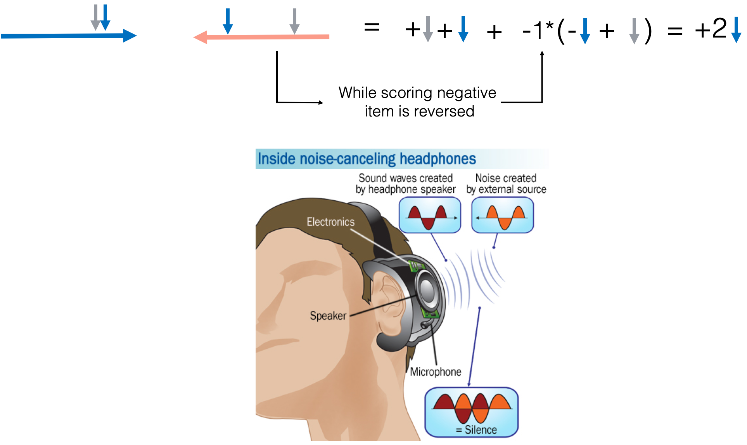
Balanced scales: have a noise canceling mechanism built in
Notes:
Total scores in balanced scales ACQ is automatically cancelled (partialed out)
Item scores are not, You need to do mannualy
Unbalanced scales a parcel of ACQ is cancelled but with trait as well . We need manually to average agreement with positive and negative and subtract

Slide 49
